Slide 1
Dynamic Programming
Principle of optimality
0/1 Knapsack
Largest Common Subsequence
Travelling Salesperson Problem
Multistage Graph problem (using Forward computation)
(Ref. Horowithz Sahni and Parag Dave )

Slide 2
Dynamic Programming
Dynamic programming is typically applied to optimization problem.
Dynamic Programming is an algorithm design method that can be used when the solution to a problem may be viewed as the result of a sequence of decisions

Slide 3
Why Dynamic Programming?
Divide-and-Conquer : a top-down approach.
partitions a problem into independent subproblems
Greedy method : only works with the local information
Dynamic programming :a bottom-up approach.
Solutions for smaller instances are stored in a table for later use.

Slide 4
Comparison with divide-and-conquer
Divide-and-conquer algorithms split a problem into separate subproblems, solve the subproblems, and combine the results for a solution to the original problem
  Example: Quicksort
  Example: Mergesort
  Example: Binary search
Divide-and-conquer algorithms can be thought of as top-down algorithms
In contrast, a dynamic programming algorithm proceeds by solving small problems, then combining them to find the solution to larger problems
Dynamic programming can be thought of as bottom-up

Slide 5
Comparison with Greedy Approach
Greedy and Dynamic Programming are methods for solving optimization problems.
However, often you need to use dynamic programming since the optimal solution cannot be guaranteed by a greedy algorithm.
Dynamic Programming provides efficient solutions for some problems for which a brute force approach would be very slow.
To use Dynamic Programming we need only show that the principle of optimality applies to the problem.

Slide 6
Elements of Dynamic Programming …
Principle of optimality
  In an optimal sequence of decisions or choices, each subsequence must also be optimal.
Memorization (for overlapping sub-problems)
  avoid calculating the same thing twice,
  usually by keeping a table of know results that fills up as sub-instances are solved.

Slide 7
Example: Fibonacci numbers
Fibonacci numbers: 0, 1, 1, 2, 3, 5, 8, 13, 21, 24
  Computing the n^{th} fibonacci number using bottom-up iteration:
f(0) = 0
f(1) = 1
f(2) = 0+1 = 1
f(3) = 1+1 = 2
f(4) = 1+2 = 3
f(5) = 2+3 = 5
f(n-2) = f(n-3)+f(n-4)
f(n-1) = f(n-2)+f(n-3)
f(n) = f(n-1) + f(n-2)

Slide 8
Recall definition of Fibonacci numbers:
  f(0) = 0
  f(1) = 1
  f(n) = f(n-1) + f(n-2) for n ≥ 2
Computing the n^{th} Fibonacci number recursively (top-down): f(n)
f(n-1) + f(n-2)
f(n-2) + f(n-3) f(n-3) + f(n-4)
...

Slide 9
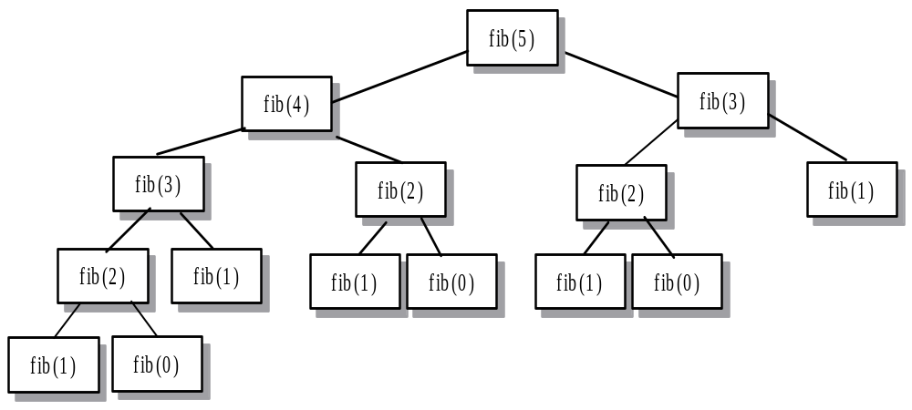
Recursive calls for fib

Slide 10
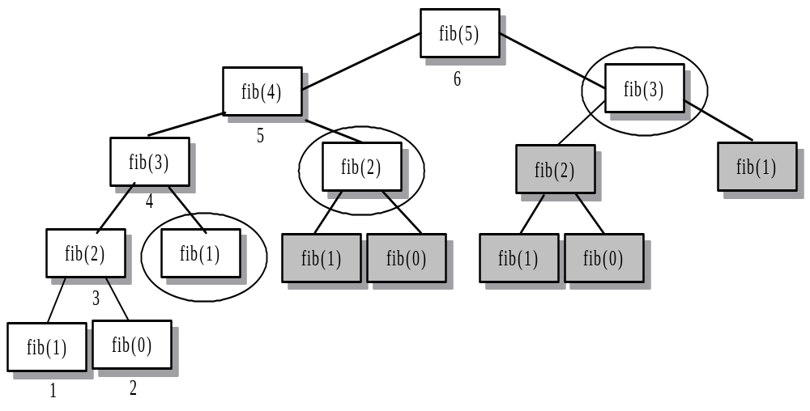
fib Using Dynamic Programming

Slide 11
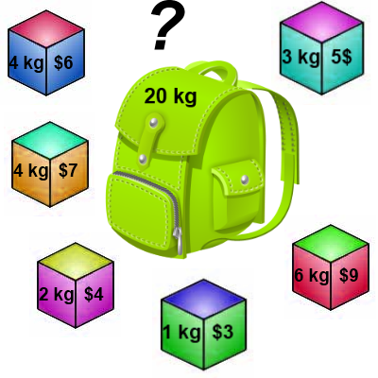
Knapsack 0-1 Problem
The difference between this problem and the fractional knapsack one is that you CANNOT take a fraction of an item.
  You can either take it or not.
  Hence the name Knapsack 0-1 problem.

Slide 12
Knapsack 0-1 Problem
As we did before we are going to solve the problem in terms of sub-problems.
  So let’s try to do that…
Our first attempt might be to characterize a sub-problem as follows:
  Let S_{k} be the optimal subset of elements from {I₀, I₁, …, I_{k}}.
    What we find is that the optimal subset from the elements {I₀, I₁, …, I_{k+1}} may not correspond to the optimal subset of elements from {I₀, I₁, …, I_{k}} in any regular pattern.
  Basically, the solution to the optimization problem for S_{k+1} might NOT contain the optimal solution from problem S_{k}.

Slide 13
Knapsack 0-1 Problem
Let’s illustrate that point with an example:
Item Weight Value
I₀ 3 10
I₁ 8 4
I₂ 9 9
I₃ 8 11
The maximum weight the knapsack can hold is 20.
The best set of items from {I₀, I₁, I₂} is {I₀, I₁, I₂}
BUT the best set of items from {I₀, I₁, I₂, I₃} is {I₀, I₂, I₃}.
  In this example, note that this optimal solution, {I₀, I₂, I₃}, does NOT build upon the previous optimal solution, {I₀, I₁, I₂}.
    (Instead it build's upon the solution, {I₀, I₂}, which is really the optimal subset of {I₀, I₁, I₂} with weight 12 or less.)

Slide 14
Knapsack 0-1 problem
So now we must re-work the way we build upon previous sub-problems…
  Let B[k, w] represent the maximum total value of a subset S_{k} with weight w.
  Our goal is to find B[n, W], where n is the total number of items and W is the maximal weight the knapsack can carry.
So our recursive formula for subproblems:
B[k, w] = B[k - 1,w], if w_{k} > w
= max { B[k - 1,w], B[k - 1,w - w_{k}] + v_{k}}, otherwise
this means that the best subset of S_{k} that has total weight w is:
  The best subset of S_{k-1} that has total weight w, or
  The best subset of S_{k-1} that has total weight w-w_{k} plus the item k

Slide 15
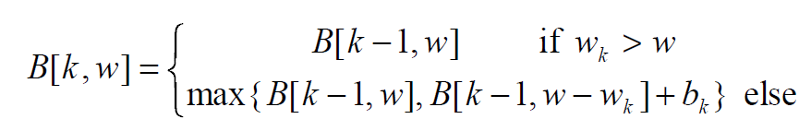
Knapsack 0-1 Problem –
Recursive Formula
The best subset of S_{k} that has the total weight w, either contains item k or not.
First case: w_{k} > w
  Item k can’t be part of the solution! If it was the total weight would be > w, which is unacceptable.
Second case: w_{k} ≤ w
  Then the item k can be in the solution, and we choose the case with greater value.

Slide 16
Knapsack 0-1 Algorithm
for w = 0 to W { // Initialize 1st row to 0’s
B[0,w] = 0
}
for i = 1 to n { // Initialize 1st column to 0’s
B[i,0] = 0
}
for i = 1 to n {
for w = 0 to W {
if w_{i} <= w { //item i can be in the solution
if v_{i} + B[i-1,w-w_{i}] > B[i-1,w]
B[i,w] = v_{i} + B[i-1,w- w_{i}]
else
B[i,w] = B[i-1,w]
}
else B[i,w] = B[i-1,w] // w_{i} > w
}
}

Slide 17
Knapsack 0-1 Problem
Let’s run our algorithm on the following data:
  n = 4 (# of elements)
  W = 5 (max weight)
  Elements (weight, value):
  (2,3), (3,4), (4,5), (5,6)

Slide 18
Knapsack 0-1 Example
i / w | 0 | 1 | 2 | 3 | 4 | 5
0 | 0 | 0 | 0 | 0 | 0 | 0
1 | 0
2 | 0
3 | 0
4 | 0
// Initialize the base cases
for w = 0 to W
B[0,w] = 0
for i = 1 to n
B[i,0] = 0

Slide 19
Knapsack 0-1 Example
Items:
1: (2,3)
2: (3,4)
3: (4,5)
4: (5,6)
i / w | 0 | 1 | 2 | 3 | 4 | 5
0 | 0 | 0 | 0 | 0 | 0 | 0
1 | 0
2 | 0
3 | 0
4 | 0
i / w | 0 | 1 | 2 | 3 | 4 | 5
0 | 0 | 0 | 0 | 0 | 0 | 0
1 | 0 | 0
2 | 0
3 | 0
4 | 0
i = 1
v_{i} = 3
w_{i} = 2
w = 1
w-w_{i} = -1
if w_{i} <= w //item i can be in the solution
if v_{i} + B[i-1,w-w_{i}] > B[i-1,w]
B[i,w] = v_{i} + B[i-1,w- w_{i}]
else
B[i,w] = B[i-1,w]
else B[i,w] = B[i-1,w] // w_{i} > w

Slide 20
Knapsack 0-1 Example
Items:
1: (2,3)
2: (3,4)
3: (4,5)
4: (5,6)
i / w | 0 | 1 | 2 | 3 | 4 | 5
0 | 0 | 0 | 0 | 0 | 0 | 0
1 | 0 | 0
2 | 0
3 | 0
4 | 0
i / w | 0 | 1 | 2 | 3 | 4 | 5
0 | 0 | 0 | 0 | 0 | 0 | 0
1 | 0 | 0 | 3
2 | 0
3 | 0
4 | 0
i = 1
v_{i} = 3
w_{i} = 2
w = 2
w-w_{i} = 0
if w_{i} <= w //item i can be in the solution
if v_{i} + B[i-1,w-w_{i}] > B[i-1,w]
B[i,w] = v_{i} + B[i-1,w- w_{i}]
else
B[i,w] = B[i-1,w]
else B[i,w] = B[i-1,w] // w_{i} > w
if w_{i} <= w //item i can be in the solution
if v_{i} + B[i-1,w-w_{i}] > B[i-1,w]
B[i,w] = v_{i} + B[i-1,w- w_{i}]
else
B[i,w] = B[i-1,w]
else B[i,w] = B[i-1,w] // w_{i} > w

Slide 21
Knapsack 0-1 Example
Items:
1: (2,3)
2: (3,4)
3: (4,5)
4: (5,6)
i / w | 0 | 1 | 2 | 3 | 4 | 5
0 | 0 | 0 | 0 | 0 | 0 | 0
1 | 0 | 0 | 3
2 | 0
3 | 0
4 | 0
i / w | 0 | 1 | 2 | 3 | 4 | 5
0 | 0 | 0 | 0 | 0 | 0 | 0
1 | 0 | 0 | 3 | 3
2 | 0
3 | 0
4 | 0
i = 1
v_{i} = 3
w_{i} = 2
w = 3
w-w_{i} = 1
if w_{i} <= w //item i can be in the solution
if v_{i} + B[i-1,w-w_{i}] > B[i-1,w]
B[i,w] = v_{i} + B[i-1,w- w_{i}]
else
B[i,w] = B[i-1,w]
else B[i,w] = B[i-1,w] // w_{i} > w

Slide 22
Knapsack 0-1 Example
Items:
1: (2,3)
2: (3,4)
3: (4,5)
4: (5,6)
i / w | 0 | 1 | 2 | 3 | 4 | 5
0 | 0 | 0 | 0 | 0 | 0 | 0
1 | 0 | 0 | 3 | 3
2 | 0
3 | 0
4 | 0
i / w | 0 | 1 | 2 | 3 | 4 | 5
0 | 0 | 0 | 0 | 0 | 0 | 0
1 | 0 | 0 | 3 | 3 | 3
2 | 0
3 | 0
4 | 0
i = 1
v_{i} = 3
w_{i} = 2
w = 4
w-w_{i} = 2
if w_{i} <= w //item i can be in the solution
if v_{i} + B[i-1,w-w_{i}] > B[i-1,w]
B[i,w] = v_{i} + B[i-1,w- w_{i}]
else
B[i,w] = B[i-1,w]
else B[i,w] = B[i-1,w] // w_{i} > w

Slide 23
Knapsack 0-1 Example
Items:
1: (2,3)
2: (3,4)
3: (4,5)
4: (5,6)
i / w | 0 | 1 | 2 | 3 | 4 | 5
0 | 0 | 0 | 0 | 0 | 0 | 0
1 | 0 | 0 | 3 | 3 | 3
2 | 0
3 | 0
4 | 0
i / w | 0 | 1 | 2 | 3 | 4 | 5
0 | 0 | 0 | 0 | 0 | 0 | 0
1 | 0 | 0 | 3 | 3 | 3 | 3
2 | 0
3 | 0
4 | 0
i = 1
v_{i} = 3
w_{i} = 2
w = 5
w-w_{i} = 3
if w_{i} <= w //item i can be in the solution
if v_{i} + B[i-1,w-w_{i}] > B[i-1,w]
B[i,w] = v_{i} + B[i-1,w- w_{i}]
else
B[i,w] = B[i-1,w]
else B[i,w] = B[i-1,w] // w_{i} > w

Slide 24
Knapsack 0-1 Example
Items:
1: (2,3)
2: (3,4)
3: (4,5)
4: (5,6)
i / w | 0 | 1 | 2 | 3 | 4 | 5
0 | 0 | 0 | 0 | 0 | 0 | 0
1 | 0 | 0 | 3 | 3 | 3 | 3
2 | 0
3 | 0
4 | 0
i / w | 0 | 1 | 2 | 3 | 4 | 5
0 | 0 | 0 | 0 | 0 | 0 | 0
1 | 0 | 0 | 3 | 3 | 3 | 3
2 | 0 | 0
3 | 0
4 | 0
i = 2
v_{i} = 4
w_{i} = 3
w = 1
w-w_{i} = -2
if w_{i} <= w //item i can be in the solution
if v_{i} + B[i-1,w-w_{i}] > B[i-1,w]
B[i,w] = v_{i} + B[i-1,w- w_{i}]
else
B[i,w] = B[i-1,w]
else B[i,w] = B[i-1,w] // w_{i} > w
if w_{i} <= w //item i can be in the solution
if v_{i} + B[i-1,w-w_{i}] > B[i-1,w]
B[i,w] = v_{i} + B[i-1,w- w_{i}]
else
B[i,w] = B[i-1,w]
else B[i,w] = B[i-1,w] // w_{i} > w

Slide 25
Knapsack 0-1 Example
Items:
1: (2,3)
2: (3,4)
3: (4,5)
4: (5,6)
i / w | 0 | 1 | 2 | 3 | 4 | 5
0 | 0 | 0 | 0 | 0 | 0 | 0
1 | 0 | 0 | 3 | 3 | 3 | 3
2 | 0 | 0
3 | 0
4 | 0
i / w | 0 | 1 | 2 | 3 | 4 | 5
0 | 0 | 0 | 0 | 0 | 0 | 0
1 | 0 | 0 | 3 | 3 | 3 | 3
2 | 0 | 0 | 3
3 | 0
4 | 0
i = 2
v_{i} = 4
w_{i} = 3
w = 2
w-w_{i} = -1
if w_{i} <= w //item i can be in the solution
if v_{i} + B[i-1,w-w_{i}] > B[i-1,w]
B[i,w] = v_{i} + B[i-1,w- w_{i}]
else
B[i,w] = B[i-1,w]
else B[i,w] = B[i-1,w] // w_{i} > w

Slide 26
Knapsack 0-1 Example
Items:
1: (2,3)
2: (3,4)
3: (4,5)
4: (5,6)
i / w | 0 | 1 | 2 | 3 | 4 | 5
0 | 0 | 0 | 0 | 0 | 0 | 0
1 | 0 | 0 | 3 | 3 | 3 | 3
2 | 0 | 0 | 3
3 | 0
4 | 0
i / w | 0 | 1 | 2 | 3 | 4 | 5
0 | 0 | 0 | 0 | 0 | 0 | 0
1 | 0 | 0 | 3 | 3 | 3 | 3
2 | 0 | 0 | 3 | 4
3 | 0
4 | 0
i = 2
v_{i} = 4
w_{i} = 3
w = 3
w-w_{i} = 0
if w_{i} <= w //item i can be in the solution
if v_{i} + B[i-1,w-w_{i}] > B[i-1,w]
B[i,w] = v_{i} + B[i-1,w- w_{i}]
else
B[i,w] = B[i-1,w]
else B[i,w] = B[i-1,w] // w_{i} > w
if w_{i} <= w //item i can be in the solution
if v_{i} + B[i-1,w-w_{i}] > B[i-1,w]
B[i,w] = v_{i} + B[i-1,w- w_{i}]
else
B[i,w] = B[i-1,w]
else B[i,w] = B[i-1,w] // w_{i} > w

Slide 27
Knapsack 0-1 Example
Items:
1: (2,3)
2: (3,4)
3: (4,5)
4: (5,6)
i / w | 0 | 1 | 2 | 3 | 4 | 5
0 | 0 | 0 | 0 | 0 | 0 | 0
1 | 0 | 0 | 3 | 3 | 3 | 3
2 | 0 | 0 | 3 | 4
3 | 0
4 | 0
i / w | 0 | 1 | 2 | 3 | 4 | 5
0 | 0 | 0 | 0 | 0 | 0 | 0
1 | 0 | 0 | 3 | 3 | 3 | 3
2 | 0 | 0 | 3 | 4 | 4
3 | 0
4 | 0
i = 2
v_{i} = 4
w_{i} = 3
w = 4
w-w_{i} = 1
if w_{i} <= w //item i can be in the solution
if v_{i} + B[i-1,w-w_{i}] > B[i-1,w]
B[i,w] = v_{i} + B[i-1,w- w_{i}]
else
B[i,w] = B[i-1,w]
else B[i,w] = B[i-1,w] // w_{i} > w

Slide 28
Knapsack 0-1 Example
Items:
1: (2,3)
2: (3,4)
3: (4,5)
4: (5,6)
i / w | 0 | 1 | 2 | 3 | 4 | 5
0 | 0 | 0 | 0 | 0 | 0 | 0
1 | 0 | 0 | 3 | 3 | 3 | 3
2 | 0 | 0 | 3 | 4 | 4
3 | 0
4 | 0
i / w | 0 | 1 | 2 | 3 | 4 | 5
0 | 0 | 0 | 0 | 0 | 0 | 0
1 | 0 | 0 | 3 | 3 | 3 | 3
2 | 0 | 0 | 3 | 4 | 4 | 7
3 | 0
4 | 0
i = 2
v_{i} = 4
w_{i} = 3
w = 5
w-w_{i} = 2
if w_{i} <= w //item i can be in the solution
if v_{i} + B[i-1,w-w_{i}] > B[i-1,w]
B[i,w] = v_{i} + B[i-1,w- w_{i}]
else
B[i,w] = B[i-1,w]
else B[i,w] = B[i-1,w] // w_{i} > w

Slide 29
Knapsack 0-1 Example
Items:
1: (2,3)
2: (3,4)
3: (4,5)
4: (5,6)
i / w | 0 | 1 | 2 | 3 | 4 | 5
0 | 0 | 0 | 0 | 0 | 0 | 0
1 | 0 | 0 | 3 | 3 | 3 | 3
2 | 0 | 0 | 3 | 4 | 4 | 7
3 | 0
4 | 0
i / w | 0 | 1 | 2 | 3 | 4 | 5
0 | 0 | 0 | 0 | 0 | 0 | 0
1 | 0 | 0 | 3 | 3 | 3 | 3
2 | 0 | 0 | 3 | 4 | 4 | 7
3 | 0 | 0 | 3 | 4
4 | 0
i = 3
v_{i} = 5
w_{i} = 4
w = 1..3
w-w_{i} = -3..-1
if w_{i} <= w //item i can be in the solution
if v_{i} + B[i-1,w-w_{i}] > B[i-1,w]
B[i,w] = v_{i} + B[i-1,w- w_{i}]
else
B[i,w] = B[i-1,w]
else B[i,w] = B[i-1,w] // w_{i} > w
if w_{i} <= w //item i can be in the solution
if v_{i} + B[i-1,w-w_{i}] > B[i-1,w]
B[i,w] = v_{i} + B[i-1,w- w_{i}]
else
B[i,w] = B[i-1,w]
else B[i,w] = B[i-1,w] // w_{i} > w

Slide 30
Knapsack 0-1 Example
Items:
1: (2,3)
2: (3,4)
3: (4,5)
4: (5,6)
i / w | 0 | 1 | 2 | 3 | 4 | 5
0 | 0 | 0 | 0 | 0 | 0 | 0
1 | 0 | 0 | 3 | 3 | 3 | 3
2 | 0 | 0 | 3 | 4 | 4 | 7
3 | 0 | 0 | 3 | 4
4 | 0
i / w | 0 | 1 | 2 | 3 | 4 | 5
0 | 0 | 0 | 0 | 0 | 0 | 0
1 | 0 | 0 | 3 | 3 | 3 | 3
2 | 0 | 0 | 3 | 4 | 4 | 7
3 | 0 | 0 | 3 | 4 | 5
4 | 0
i = 3
v_{i} = 5
w_{i} = 4
w = 4
w-w_{i} = 0
if w_{i} <= w //item i can be in the solution
if v_{i} + B[i-1,w-w_{i}] > B[i-1,w]
B[i,w] = v_{i} + B[i-1,w- w_{i}]
else
B[i,w] = B[i-1,w]
else B[i,w] = B[i-1,w] // w_{i} > w
if w_{i} <= w //item i can be in the solution
if v_{i} + B[i-1,w-w_{i}] > B[i-1,w]
B[i,w] = v_{i} + B[i-1,w- w_{i}]
else
B[i,w] = B[i-1,w]
else B[i,w] = B[i-1,w] // w_{i} > w

Slide 31
Knapsack 0-1 Example
Items:
1: (2,3)
2: (3,4)
3: (4,5)
4: (5,6)
i / w | 0 | 1 | 2 | 3 | 4 | 5
0 | 0 | 0 | 0 | 0 | 0 | 0
1 | 0 | 0 | 3 | 3 | 3 | 3
2 | 0 | 0 | 3 | 4 | 4 | 7
3 | 0 | 0 | 3 | 4 | 5
4 | 0
i / w | 0 | 1 | 2 | 3 | 4 | 5
0 | 0 | 0 | 0 | 0 | 0 | 0
1 | 0 | 0 | 3 | 3 | 3 | 3
2 | 0 | 0 | 3 | 4 | 4 | 7
3 | 0 | 0 | 3 | 4 | 5 | 7
4 | 0
i = 3
v_{i} = 5
w_{i} = 4
w = 5
w-w_{i} = 1
if w_{i} <= w //item i can be in the solution
if v_{i} + B[i-1,w-w_{i}] > B[i-1,w]
B[i,w] = v_{i} + B[i-1,w- w_{i}]
else
B[i,w] = B[i-1,w]
else B[i,w] = B[i-1,w] // w_{i} > w
if w_{i} <= w //item i can be in the solution
if v_{i} + B[i-1,w-w_{i}] > B[i-1,w]
B[i,w] = v_{i} + B[i-1,w- w_{i}]
else
B[i,w] = B[i-1,w]
else B[i,w] = B[i-1,w] // w_{i} > w

Slide 32
Knapsack 0-1 Example
Items:
1: (2,3)
2: (3,4)
3: (4,5)
4: (5,6)
i / w | 0 | 1 | 2 | 3 | 4 | 5
0 | 0 | 0 | 0 | 0 | 0 | 0
1 | 0 | 0 | 3 | 3 | 3 | 3
2 | 0 | 0 | 3 | 4 | 4 | 7
3 | 0 | 0 | 3 | 4 | 5 | 7
4 | 0
i / w | 0 | 1 | 2 | 3 | 4 | 5
0 | 0 | 0 | 0 | 0 | 0 | 0
1 | 0 | 0 | 3 | 3 | 3 | 3
2 | 0 | 0 | 3 | 4 | 4 | 7
3 | 0 | 0 | 3 | 4 | 5 | 7
4 | 0 | 0 | 3 | 4 | 5
i = 4
v_{i} = 6
w_{i} = 5
w = 1..4
w-w_{i} = -4..-1
if w_{i} <= w //item i can be in the solution
if v_{i} + B[i-1,w-w_{i}] > B[i-1,w]
B[i,w] = v_{i} + B[i-1,w- w_{i}]
else
B[i,w] = B[i-1,w]
else B[i,w] = B[i-1,w] // w_{i} > w
if w_{i} <= w //item i can be in the solution
if v_{i} + B[i-1,w-w_{i}] > B[i-1,w]
B[i,w] = v_{i} + B[i-1,w- w_{i}]
else
B[i,w] = B[i-1,w]
else B[i,w] = B[i-1,w] // w_{i} > w

Slide 33
Knapsack 0-1 Example
Items:
1: (2,3)
2: (3,4)
3: (4,5)
4: (5,6)
i / w | 0 | 1 | 2 | 3 | 4 | 5
0 | 0 | 0 | 0 | 0 | 0 | 0
1 | 0 | 0 | 3 | 3 | 3 | 3
2 | 0 | 0 | 3 | 4 | 4 | 7
3 | 0 | 0 | 3 | 4 | 5 | 7
4 | 0 | 0 | 3 | 4 | 5
i / w | 0 | 1 | 2 | 3 | 4 | 5
0 | 0 | 0 | 0 | 0 | 0 | 0
1 | 0 | 0 | 3 | 3 | 3 | 3
2 | 0 | 0 | 3 | 4 | 4 | 7
3 | 0 | 0 | 3 | 4 | 5 | 7
4 | 0 | 0 | 3 | 4 | 5 | 7
i = 4
v_{i} = 6
w_{i} = 5
w = 5
w-w_{i} = 0
if w_{i} <= w //item i can be in the solution
if v_{i} + B[i-1,w-w_{i}] > B[i-1,w]
B[i,w] = v_{i} + B[i-1,w- w_{i}]
else
B[i,w] = B[i-1,w]
else B[i,w] = B[i-1,w] // w_{i} > w
if w_{i} <= w //item i can be in the solution
if v_{i} + B[i-1,w-w_{i}] > B[i-1,w]
B[i,w] = v_{i} + B[i-1,w- w_{i}]
else
B[i,w] = B[i-1,w]
else B[i,w] = B[i-1,w] // w_{i} > w

Slide 34
Knapsack 0-1 Example
Items:
1: (2,3)
2: (3,4)
3: (4,5)
4: (5,6)
i / w | 0 | 1 | 2 | 3 | 4 | 5
0 | 0 | 0 | 0 | 0 | 0 | 0
1 | 0 | 0 | 3 | 3 | 3 | 3
2 | 0 | 0 | 3 | 4 | 4 | 7
3 | 0 | 0 | 3 | 4 | 5 | 7
4 | 0 | 0 | 3 | 4 | 5 | 7
We’re DONE!!
The max possible value that can be carried in this knapsack is $7

Slide 35
Knapsack 0-1 Algorithm
This algorithm only finds the max possible value that can be carried in the knapsack
  The value in B[n,W]
To know the items that make this maximum value, we need to trace back through the table.

Slide 36
Knapsack 0-1 Algorithm
Finding the Items
Let i = n and k = W
if B[i, k] ≠ B[i-1, k] then
mark the i^{th} item as in the knapsack
i = i-1, k = k-w_{i}
else
i = i-1 // Assume the i^{th} item is not in the knapsack
// Could it be in the optimally packed knapsack?

Slide 37
Knapsack 0-1 Algorithm
Finding the Items
Items:
1: (2,3)
2: (3,4)
3: (4,5)
4: (5,6)
Knapsack:
i / w | 0 | 1 | 2 | 3 | 4 | 5
0 | 0 | 0 | 0 | 0 | 0 | 0
1 | 0 | 0 | 3 | 3 | 3 | 3
2 | 0 | 0 | 3 | 4 | 4 | 7
3 | 0 | 0 | 3 | 4 | 5 | 7
4 | 0 | 0 | 3 | 4 | 5 | 7
i = 4
k = 5
v_{i} = 6
w_{i} = 5
B[i,k] = 7
B[i-1,k] = 7
i = n , k = W
while i, k > 0
if B[i, k] ≠ B[i-1, k] then
mark the i^{th} item as in the knapsack
i = i-1, k = k-w_{i}
else
i = i-1

Slide 38
Knapsack 0-1 Algorithm
Finding the Items
Items:
1: (2,3)
2: (3,4)
3: (4,5)
4: (5,6)
Knapsack:
i / w | 0 | 1 | 2 | 3 | 4 | 5
0 | 0 | 0 | 0 | 0 | 0 | 0
1 | 0 | 0 | 3 | 3 | 3 | 3
2 | 0 | 0 | 3 | 4 | 4 | 7
3 | 0 | 0 | 3 | 4 | 5 | 7
4 | 0 | 0 | 3 | 4 | 5 | 7
i = 3
k = 5
v_{i} = 5
w_{i} = 4
B[i,k] = 7
B[i-1,k] = 7
i = n , k = W
while i, k > 0
if B[i, k] ≠ B[i-1, k] then
mark the i^{th} item as in the knapsack
i = i-1, k = k-w_{i}
else
i = i-1

Slide 39
Knapsack 0-1 Algorithm
Finding the Items
Items:
1: (2,3)
2: (3,4)
3: (4,5)
4: (5,6)
Knapsack:
Item 2
i / w | 0 | 1 | 2 | 3 | 4 | 5
0 | 0 | 0 | 0 | 0 | 0 | 0
1 | 0 | 0 | 3 | 3 | 3 | 3
2 | 0 | 0 | 3 | 4 | 4 | 7
3 | 0 | 0 | 3 | 4 | 5 | 7
4 | 0 | 0 | 3 | 4 | 5 | 7
i = 2
k = 5
v_{i} = 4
w_{i} = 3
B[i,k] = 7
B[i-1,k] = 3
k – w_{i} = 2
i = n , k = W
while i, k > 0
if B[i, k] ≠ B[i-1, k] then
mark the i^{th} item as in the knapsack
i = i-1, k = k-w_{i}
else
i = i-1

Slide 40
Knapsack 0-1 Algorithm
Finding the Items
Items:
1: (2,3)
2: (3,4)
3: (4,5)
4: (5,6)
Knapsack:
Item 2
Item 1
i / w | 0 | 1 | 2 | 3 | 4 | 5
0 | 0 | 0 | 0 | 0 | 0 | 0
1 | 0 | 0 | 3 | 3 | 3 | 3
2 | 0 | 0 | 3 | 4 | 4 | 7
3 | 0 | 0 | 3 | 4 | 5 | 7
4 | 0 | 0 | 3 | 4 | 5 | 7
i = 1
k = 2
v_{i} = 3
w_{i} = 2
B[i,k] = 3
B[i-1,k] = 0
k – w_{i} = 0
i = n , k = W
while i, k > 0
if B[i, k] ≠ B[i-1, k] then
mark the i^{th} item as in the knapsack
i = i-1, k = k-w_{i}
else
i = i-1

Slide 41
Knapsack 0-1 Algorithm
Finding the Items
Items:
1: (2,3)
2: (3,4)
3: (4,5)
4: (5,6)
Knapsack:
Item 2
Item 1
i / w | 0 | 1 | 2 | 3 | 4 | 5
0 | 0 | 0 | 0 | 0 | 0 | 0
1 | 0 | 0 | 3 | 3 | 3 | 3
2 | 0 | 0 | 3 | 4 | 4 | 7
3 | 0 | 0 | 3 | 4 | 5 | 7
4 | 0 | 0 | 3 | 4 | 5 | 7
i = 1
k = 2
v_{i} = 3
w_{i} = 2
B[i,k] = 3
B[i-1,k] = 0
k – w_{i} = 0
k = 0, so we’re DONE!
The optimal knapsack should contain:
Item 1 and Item 2

Slide 42
Knapsack 0-1 Problem – Run Time
for w = 0 to W
B[0,w] = 0
for i = 1 to n
B[i,0] = 0
for i = 1 to n
for w = 0 to W
< the rest of the code >
What is the running time of this algorithm?
O(n*W)
Remember that the brute-force algorithm takes: O(2^{n})
Brute-force search or exhaustive search, also known as generate and test, is a very general problem solving technique and algorithmic paradigm that consists of systematically enumerating all possible candidates for the solution and checking whether each candidate satisfies the problem's statement.
O(W)
O(n)
Repeat n times
O(W)

Slide 43
Consider the problem having weights and profits are:
Weights: {3, 4, 6, 5}
Profits: {2, 3, 1, 4}
The weight of the knapsack is 8 kg
The number of items is 4

Slide 44


The 0-1 knapsack problem
A solution to the knapsack problem may be obtained by making a sequence
of decisions on the variables x1, x2, ... , xn. A decision on variable x; involves deciding which of the values 0 or 1 is to be assigned to it.
Let (X) be the value of an optimal solution to KNAP(l,j, X). Since the
principle of optimality holds, we obtain
For arbitrary Equation generalizes to
Equation may be solved by beginning with the knowledge
for all X and may be successively
computed using equation 2.

Slide 45

The 0-1 knapsack problem
(Ref. Horowithz Sahni , page no-305)
Consider the knapsack instance n = 3, (w1, w2,w3) =
(2, 3, 4), (p1, p2, p3) = (1, 2, 5) and M = 6.
Initially compute
S⁰ ={(0,0)}
Where S^{i} may now be obtained by merging together S^{i-1} and s^{i}₁.
Purging Rule: If s_{i+1} contains (P_{j}, W_{j}) and (P_{k}, W_{k}); these two pairs such that P_{j} <= P_{k} and W_{j} >= W_{k}, then (P_{j}, W_{j}) can be eliminated . This purging rule is also called as dominance rule. In short, remove the pair with less profit and more weight.

Slide 46
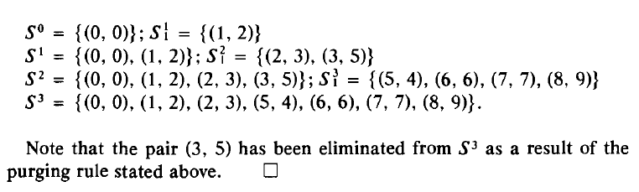
The 0-1 knapsack problem

Slide 47
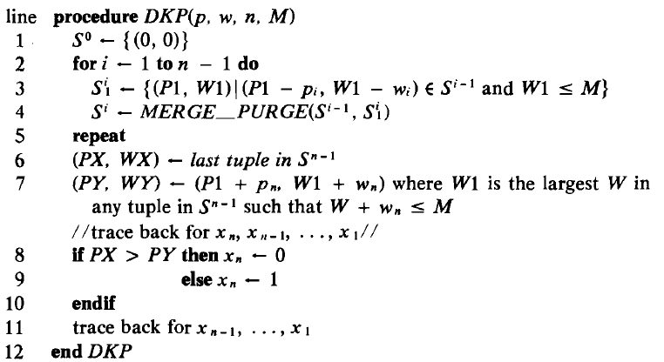
The 0-1 knapsack problem

Slide 48
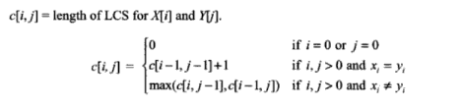
Largest/Longest Common Subsequence (LCS)
(Ref. Parag Dave, page no-285)
A subsequence is a sequence that appears in the same relative order, but not necessarily contiguous. For example, “abc”, “abg”, “bdf”, “aeg”, ‘”acefg”, .. etc are subsequences of “abcdefg”.
Problem:
Given two sequences X = <x1,x2,…xm> and Y = <y1,y2,…yn> , Find the longest sub-sequence Z = <z1,….zk> that is common to X and Y.
For example:
If X = < A,B,C,B,D,A,B> and Y = <B,D,C,A,B,A>
then some common sub-sequences are:
{A} {B} {C} {D} {A,A} {B,B} {B,C,A} {B,C,A} {B,C,B,A } {B,D,A,B}
From which {B,C,B,A } {B,D,A,B} are the Longest Common sub-sequences.
C[i, j]= length of LCS for X[i] and Y[j] ➔

Slide 49
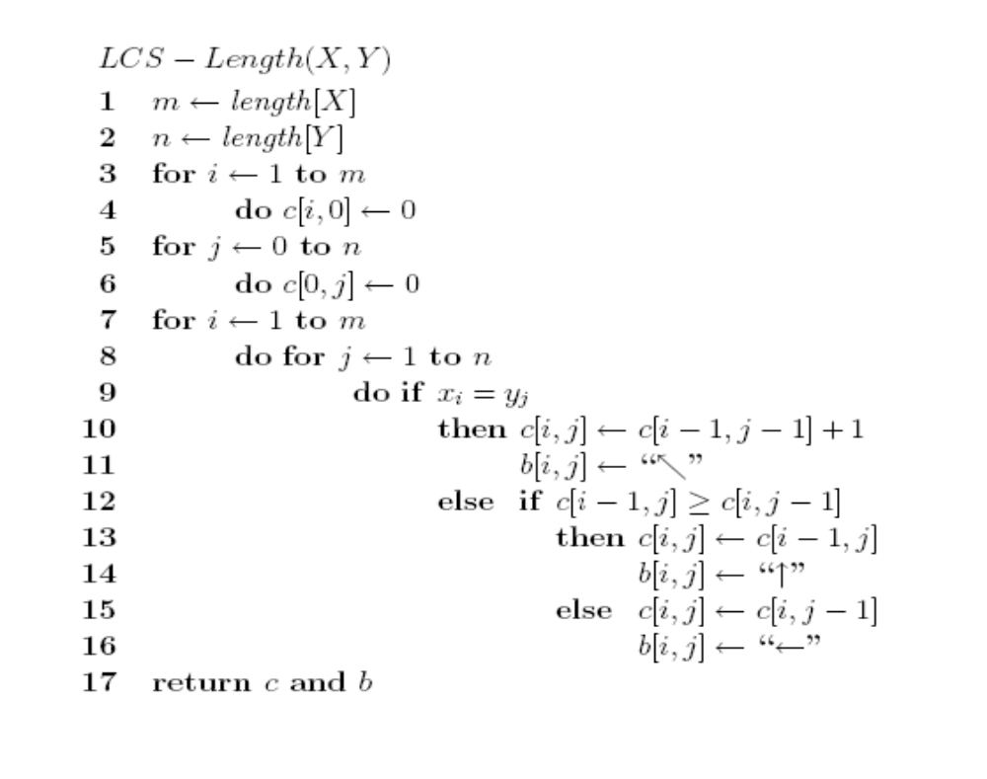

Slide 50
PRINT-LCS (b, x, i, j)
1. if i=0 or j=0
2. then return
3. if b [i,j] = ' ↖ '
4. then PRINT-LCS (b,x,i-1,j-1)
5. print x_i
6. else if b [i,j] = ' ↑ '
7. then PRINT-LCS (b,X,i-1,j)
8. else PRINT-LCS (b,X,i,j-1)

Slide 51
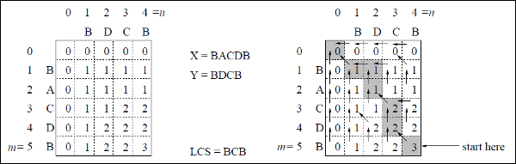
Largest/Longest Common Subsequence (LCS)
Example:
Given two strings are X = BACDB and Y = BDCB
find the longest common subsequence.

Slide 52
Travelling Salesman Problem
(Ref. Horowithz Sahni , page no-319)
In the traveling salesman problem, a map of cities is given to the salesman and he has to visit all the cities only once and return to his starting point to complete the tour in such a way that the length of the tour is the shortest among all possible tours for this map.
Clearly starting from a given city, the salesman will have a total of (n-1)! Different sequences:
If n = 2, A and B, there is no choice.
If n = 3, i.e. he wants to visit three cities
inclusive of the starting point, he has 2! Possible routes and so on.

Slide 53
Travelling Salesman Problem
(Ref. Horowithz Sahni , page no-319)
The Dynamic Programming proceeds as follows:-
Step-1
Consider the given travelling salesman problem in which he wants to find that route which has shortest distance.
Step-2
Consider set of 0element, such that
g(2, Φ ) = c21 g(3, Φ ) = c31 g(4, Φ ) = c41
Step-3
After completion of step-2, consider sets of 1 elements, such that
Set {2}: g(3,{2}) = c32 + g(2, Φ ) = c32 + c21
g(4,{2}) = c42 + g(2, Φ ) = c42 + c21
Set {3}: g(2,{3}) = c23 + g(3, Φ ) = c23 + c31
g(4,{3}) = c43 + g(3, Φ) = c43 + c31
Set {4}: g(2,{4}) = c24 + g(4, Φ ) = c24 + c41
g(3,{4}) = c34 + g(4, Φ ) = c34 + c41
Step-4
After completion of step-3, consider sets of 2 elements, such that
Set {2,3}: g(4,{2,3}) = min {c42 + g(2,{3}), c43 + g(3,{2})}
Set {2,4}: g(3,{2,4}) = min {c32 + g(2,{4}), c34 + g(4,{2})}
Set {3,4}: g(2,{3,4}) = min {c23 + g(3,{4}), c24 + g(4,{3})}
Step-5
After completion of step-4, Find the length of an optimal tour:
f = g(1,{2,3,4}) = min { c12 + g(2,{3,4}), c13 + g(3,{2,4}), c14 + g(4,{2,3}) }
Step-6
After completion of step-5, Find the Optimal TSP tour

Slide 54
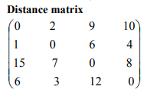
Travelling Salesman Problem
(Ref. Horowithz Sahni , page no-319)
Solve the TSP problem for given Distance matrix.
g(2, Φ ) = c21 = 1
g(3, Φ ) = c31 = 15
g(4, Φ ) = c41 = 6
k = 1, consider sets of 1 element:
Set {2}: g(3,{2}) = c32 + g(2, Φ ) = c32 + c21 = 7 + 1 = 8
g(4,{2}) = c42 + g(2, Φ ) = c42 + c21 = 3 + 1 = 4
Set {3}: g(2,{3}) = c23 + g(3, Φ ) = c23 + c31 = 6 + 15 = 21
g(4,{3}) = c43 + g(3, Φ) = c43 + c31 = 12 + 15 = 27
Set {4}: g(2,{4}) = c24 + g(4, Φ ) = c24 + c41 = 4 + 6 = 10
g(3,{4}) = c34 + g(4, Φ ) = c34 + c41 = 8 + 6 = 14
k = 2, consider sets of 2 elements:
Set {2,3}: g(4,{2,3}) = min {c42 + g(2,{3}), c43 + g(3,{2})} = min {3+21, 12+8}= min {24, 20}= 20
Set {2,4}: g(3,{2,4}) = min {c32 + g(2,{4}), c34 + g(4,{2})} = min {7+10, 8+4}= min {17, 12} = 12
Set {3,4}: g(2,{3,4}) = min {c23 + g(3,{4}), c24 + g(4,{3})} = min {6+14, 4+27}= min {20, 31}= 20
Length of an optimal tour:
f = g(1,{2,3,4}) = min { c12 + g(2,{3,4}), c13 + g(3,{2,4}), c14 + g(4,{2,3}) }
= min {2 + 20, 9 + 12, 10 + 20}
= min {22, 21, 30} = 21
Successor of node 1: c13 + g(3,{2,4}) = 3
Successor of node 3: = c34 + g(4,{2})} =4
Successor of node 4: g(4,{2}) =2
Successor of node 2: back to staring node 1
Optimal TSP tour: 1 →3 → 4 →2→1 with minimum cost= 21

Slide 55
Dynamic Programming
Dynamic Programming is an algorithm design method that can be used when the solution to a problem may be viewed as the result of a sequence of decisions
7 -<number>

Slide 56
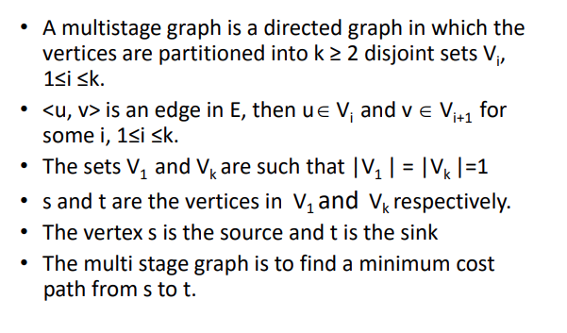
Multi-stage graph

Slide 57
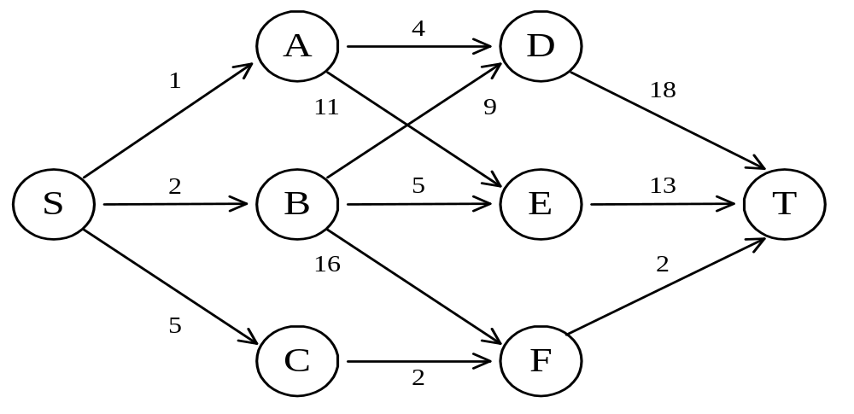
The shortest path in multistage graphs
e.g.
The greedy method can not be applied to this case: (S, A, D, T) 1+4+18 = 23.
The real shortest path is:
(S, C, F, T) 5+2+2 = 9.
7 -<number>

Slide 58
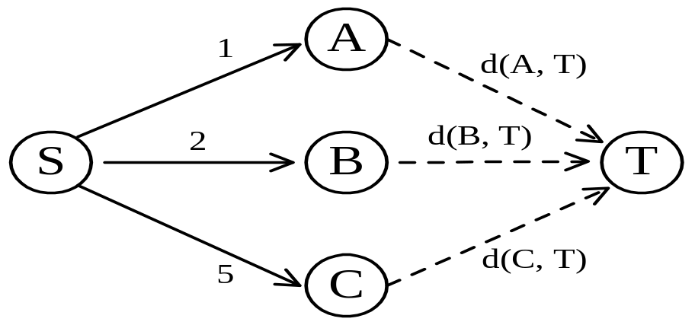
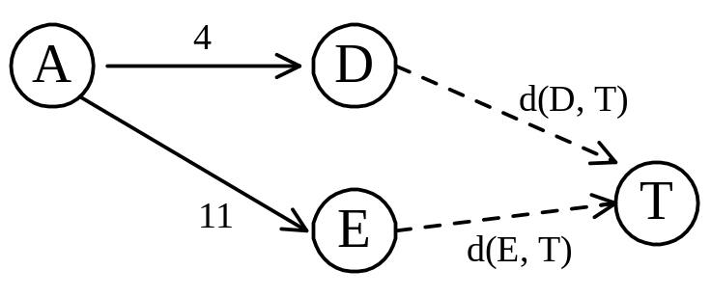
Dynamic programming approach
Dynamic programming approach (forward approach):
d(S, T) = min{1+d(A, T), 2+d(B, T), 5+d(C, T)}
d(A,T) = min{4+d(D,T), 11+d(E,T)}
= min{4+18, 11+13} = 22.
7 -<number>

Slide 59
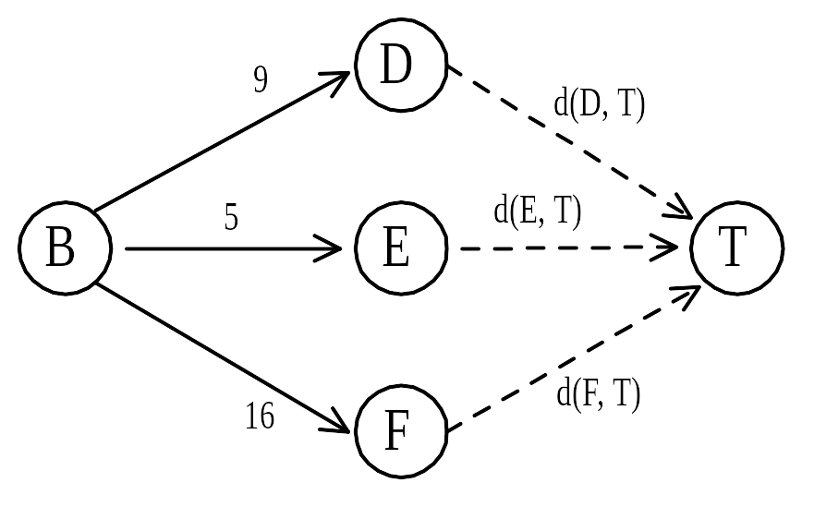
d(B, T) = min{9+d(D, T), 5+d(E, T), 16+d(F, T)}
= min{9+18, 5+13, 16+2} = 18.
d(C, T) = min{ 2+d(F, T) } = 2+2 = 4
d(S, T) = min{1+d(A, T), 2+d(B, T), 5+d(C, T)}
= min{1+22, 2+18, 5+4} = 9.
The above way of reasoning is called
backward reasoning.
7 -<number>

Slide 60
Algorithm Fgraph(G,k,n,p)
//input is k stage graph G=(V,E) with n vertices
//indexed in order of stages
// E set of edges, c[i][j] is cost of <i,j>
// p[1..k] is a minimum cost path
{
fcost[n] = 0.0;
For j= n-1 to 1 step -1 do
{ // compute fcost[j]
Let r be the vertex such that <j, r> is an edge
of G and c[j][r] + fcost[r] is minimum;
fcost[j] = c[j][r] + fcost[r];
d[j]=r ;
}
p[1]=1; p[k] = n;
for j= 2 to k-1 do p[j] = d[p[j-1]];
}
7 -<number>

Slide 61
Complexity
G represented using adjacency list
Vertex r can be found in time proportional to the degree of vertex j.
If G has |E| edges, the total time required is Ѳ(|v| +|E|)
Additional space required for cost[],d[],p[]
7 -<number>

Slide 62
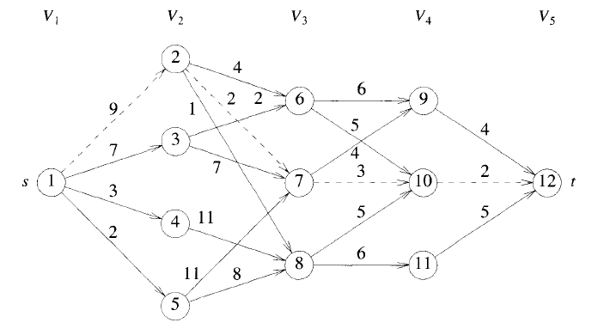

Multi-stage graph

Slide 63

Multistage Graph-forward approach

Slide 64
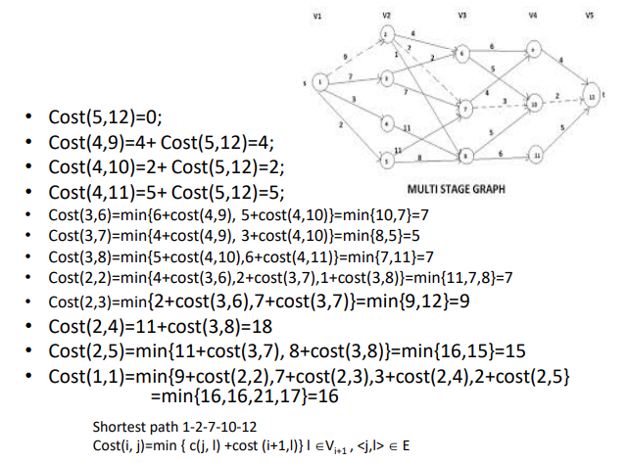

Slide 65
Backward approach
(forward reasoning)
d(S, A) = 1
d(S, B) = 2
d(S, C) = 5
d(S,D)=min{d(S,A)+d(A,D), d(S,B)+d(B,D)}
= min{ 1+4, 2+9 } = 5
d(S,E)=min{d(S,A)+d(A,E), d(S,B)+d(B,E)}
= min{ 1+11, 2+5 } = 7
d(S,F)=min{d(S,B)+d(B,F), d(S,C)+d(C,F)}
= min{ 2+16, 5+2 } = 7
7 -<number>

Slide 66
d(S,T) = min{d(S, D)+d(D, T), d(S,E)+
d(E,T), d(S, F)+d(F, T)}
= min{ 5+18, 7+13, 7+2 }
= 9
7 -<number>

Slide 67
Algorithm Bgraph(G,k,n,p)
//input is k stage graph G=(V,E) with n vertices
//indexed in order of stages
// E set of edges, c[i][j] is cost of <i,j>
// p[1..k] is a minimum cost path
{
bcost[1] = 0.0;
For j=2 to n do
{ // compute bcost[j]
Let r be the vertex such that <r, j> is an edge
of G and bcost[r] + c[r][j] is minimum;
bcost[j] = bcost[r] + c[r][j];
d[j]=r ;
}
p[1]=1; p[k] = n;
for j= k-1 to 2 do p[j] = d[p[j+1]];
}
7 -<number>

Slide 68
Principle of optimality
Principle of optimality: Suppose that in solving a problem, we have to make a sequence of decisions D₁, D₂, …, D_{n}. If this sequence is optimal, then the last k decisions, 1 < k < n must be optimal.
e.g. the shortest path problem
If i, i₁, i₂, …, j is a shortest path from i to j, then i₁, i₂, …, j must be a shortest path from i₁ to j
In summary, if a problem can be described by a multistage graph, then it can be solved by dynamic programming.
7 -<number>

Slide 69
Dynamic programming
Forward approach and backward approach:
  Note that if the recurrence relations are formulated using the forward approach then the relations are solved backwards . i.e., beginning with the last decision
  On the other hand if the relations are formulated using the backward approach, they are solved forwards.
To solve a problem by using dynamic programming:
  Find out the recurrence relations.
  Represent the problem by a multistage graph.
7 -<number>

Slide 70
The End

